Slide 1
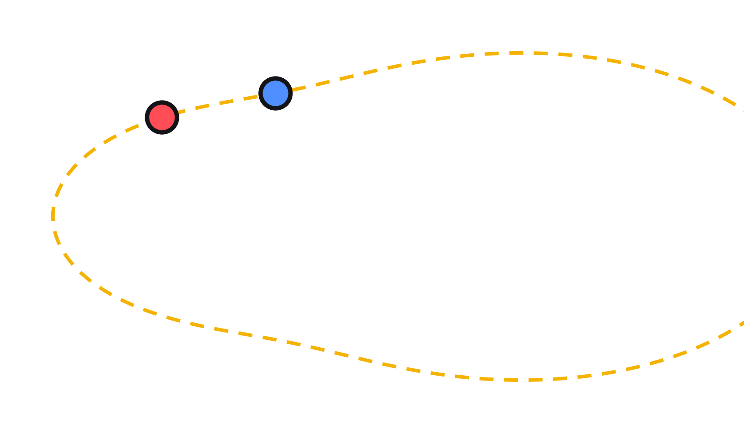
Neuroevolution of Autonomous Racing Agents
Generalization Across Track Geometries
Status report | Arshan Mukadam, Esther Cho
Notes:
Our project asks whether drivers evolved on some tracks can handle a track they never trained on. The track on the right is peanut, our held-out test track.

Slide 2

Can evolved drivers handle a new track?
THE QUESTION
SEES
7 wall sensors + speed
THINKS
Small neural network
DOES
Steer + throttle
GA
Fixed shape, evolves weights
NEAT
Evolves weights and shape
Train on some tracks, then test on one the drivers have never seen.
Notes:
2D top-down arcade racing sim in pygame. The driver only sees 7 distance rays plus its speed, and outputs steering and throttle. The GA keeps a fixed 8-8-2 network with 90 weights. NEAT starts minimal and adds structure. We also want to know if network structure affects generalization.

Slide 3
Related work
BACKGROUND
2006
2009
2018
Togelius & Lucas
Cardamone, Loiacono & Lanzi
Justesen et al.
Evolving robust and specialized car racing skills
Evolving competitive car controllers for racing games with neuroevolution
Illuminating Generalization in Deep RL through Procedural Level Generation
General drivers can be specialized for each track
NEAT learned fast driving and overtaking in TORCS
Fixed levels overfit; generated levels help
OUR ANGLE
OUR ANGLE
OUR ANGLE
We test general drivers on an unseen track
We compare NEAT with a fixed-shape GA
Same question, with evolved racing drivers
Our focus: does a fixed or evolved network shape generalize better to an unseen track?
Notes:
Togelius & Lucas: https://web-archive.southampton.ac.uk/cogprints.org/5219/index.html
Cardamone, Loiacono & Lanzi: https://re.public.polimi.it/handle/11311/565272
Justesen et al.: https://arxiv.org/abs/1806.10729
We are not claiming nobody has done this. Our focus is a direct GA vs NEAT comparison on small drivers tested on an unseen track.

Slide 4
Where we are
STATUS
W1
W2
W3
W4
W5
W6
Car + sensors
GA
NEAT
Seed sweeps
Ablations, videos
Writeup, demo
Done
Done
Done
5 of 30 seeds
Next
Next
What changed since the proposal
Tracks
Training tracks
Top speed (px/frame)
Runs per method
was imported
was 3
was 6
was 3
8 we built
7
10
5, then 30
Notes:
W1 to W3 are done: simulator, GA and NEAT. We are in W4 with 5 of 30 planned seeds per method.
Why the changes: at 6 px/frame even random drivers could lap and the train/test gap was near zero, so the task was too easy. At 10 px/frame drivers have to brake. We then found 3 training tracks did not teach enough, so we moved to 7. Building our own tracks let us check turn radii and control difficulty. Note: the 3 training tracks came from our design doc, not the written proposal.

Slide 5
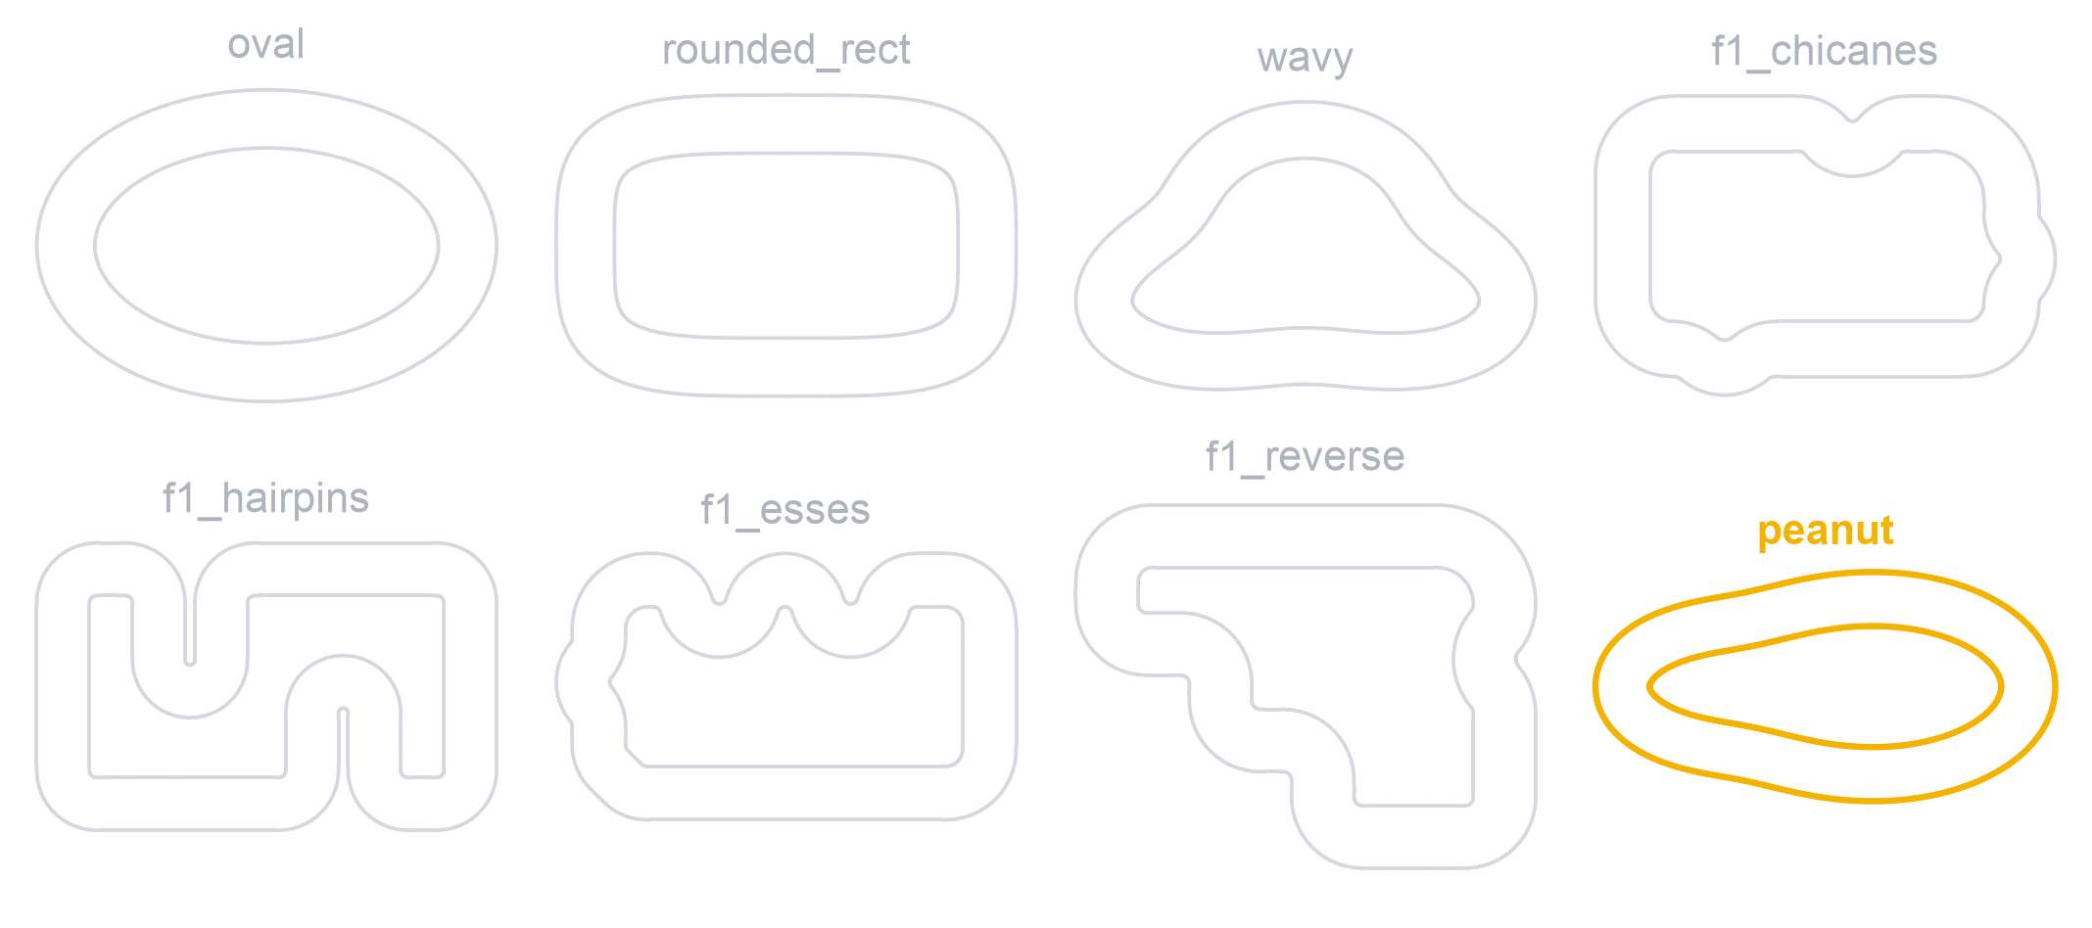
Train on 7 tracks, test on peanut
SETUP
10,000
evaluations per run
5
seeds per method
10
FITNESS
100 × checkpoints + 500 × checkpoints / frames
test episodes per champion
Notes:
Both methods get the same budget: population 100 for 100 generations. Every generation draws a new episode seed and re-scores the whole population. The champion is chosen on 5 validation seeds, then reported on 10 test seeds. An episode ends on a wall hit, after about 150 frames with no new checkpoint, or at 600 frames. We never reward raw distance.

Slide 6
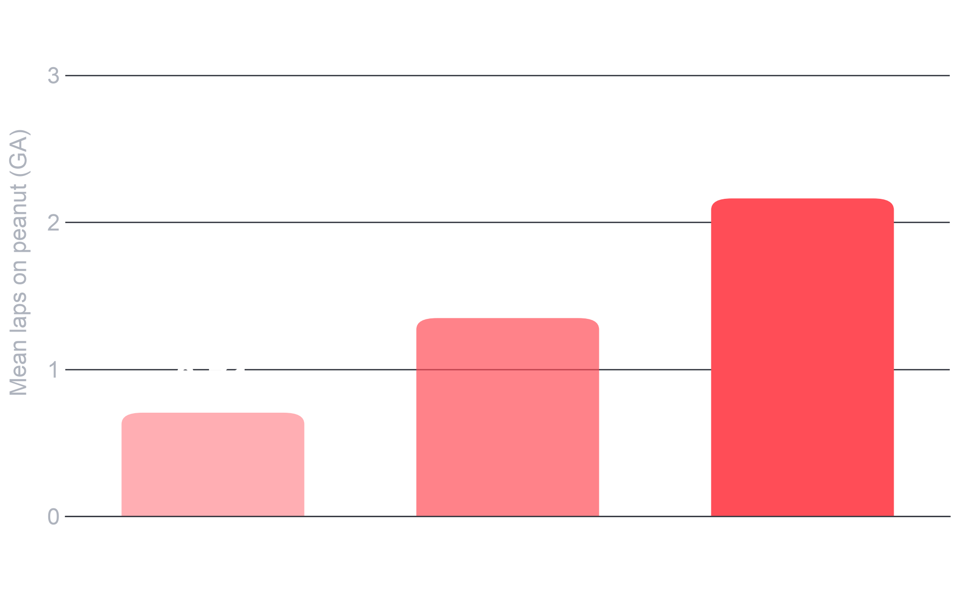
More track variety helped on peanut
RESULT 1
0 → 3 of 5
GA seeds lapping peanut with no crashes
100% → 40%
peanut crash rate, 3 basic to all 7
Drivers only learn what training demands.
Notes:
Same GA, same 10,000 evaluations, only the training set changes. 3 basic tracks: 0 of 5 seeds lap peanut, 100% crash rate. 3 F1 tracks: 2 of 5, 60% crash rate. All 7: 3 of 5, 40% crash rate. The basic-track champions never had to slow down, so they hit peanut at full speed. The hand-coded driver gets 2.85 laps with no crashes.
Caution: track count and difficulty changed together, so we can't yet say which one mattered more. Swapping only wavy for f1_esses (3 seeds) did not help: 0 of 3 lapped, 0.54 laps.

Slide 7
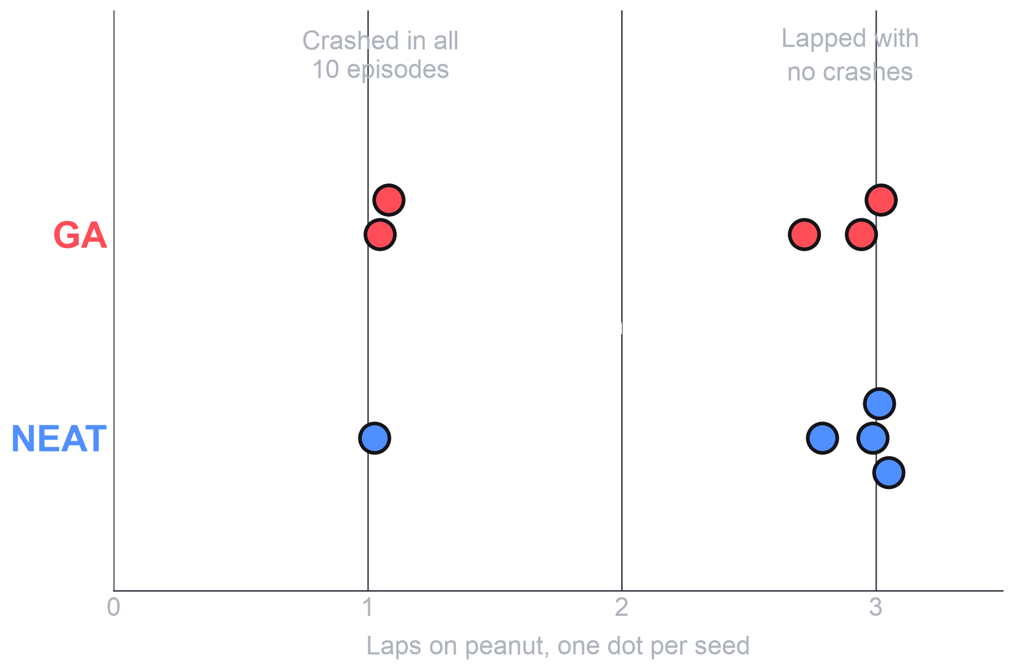
NEAT trends ahead of the GA
RESULT 2
GA
NEAT
Seeds lapping peanut clean
3/5
4/5
Peanut crash rate
40%
20%
Training crashes, of 350
76
1
The peanut gap is one seed. Training crashes are the clearer difference.
Notes:
Both methods have 5 seeds and the same budget. Each method has seeds that fail on peanut, so a single run could mislead you either way. On peanut, NEAT is 4 of 5 vs 3 of 5, which is too close to call without more seeds. Training crashes are 1 of 350 episodes for NEAT and 76 of 350 for the GA. NEAT averages 2.60 training laps vs 2.21. The hardest track, f1_hairpins, shows it best: NEAT 1.49 laps, GA 0.46.

Slide 8
How our predictions held up
HYPOTHESES
NEAT scores higher on training tracks
2.60 vs 2.21
Supported so far
NEAT vs GA, mean training laps
The GA holds up better on new tracks
2.57 vs 2.16
Not supported so far
NEAT vs GA, mean peanut laps
NEAT wins by growing a bigger network
6–12 vs 90
Opposite
NEAT connections vs GA weights
Notes:
These predictions are from our proposal. We expected NEAT to win in training because a bigger network could learn each circuit, and the GA to hold up better on new tracks. So far NEAT leads on both, and its champions are small: 0 to 3 hidden nodes and 6 to 12 enabled connections. The GA network has 90 fixed weights. NEAT's count excludes node biases, so the comparison is approximate. All of this is based on 5 seeds, so it could still change.

Slide 9
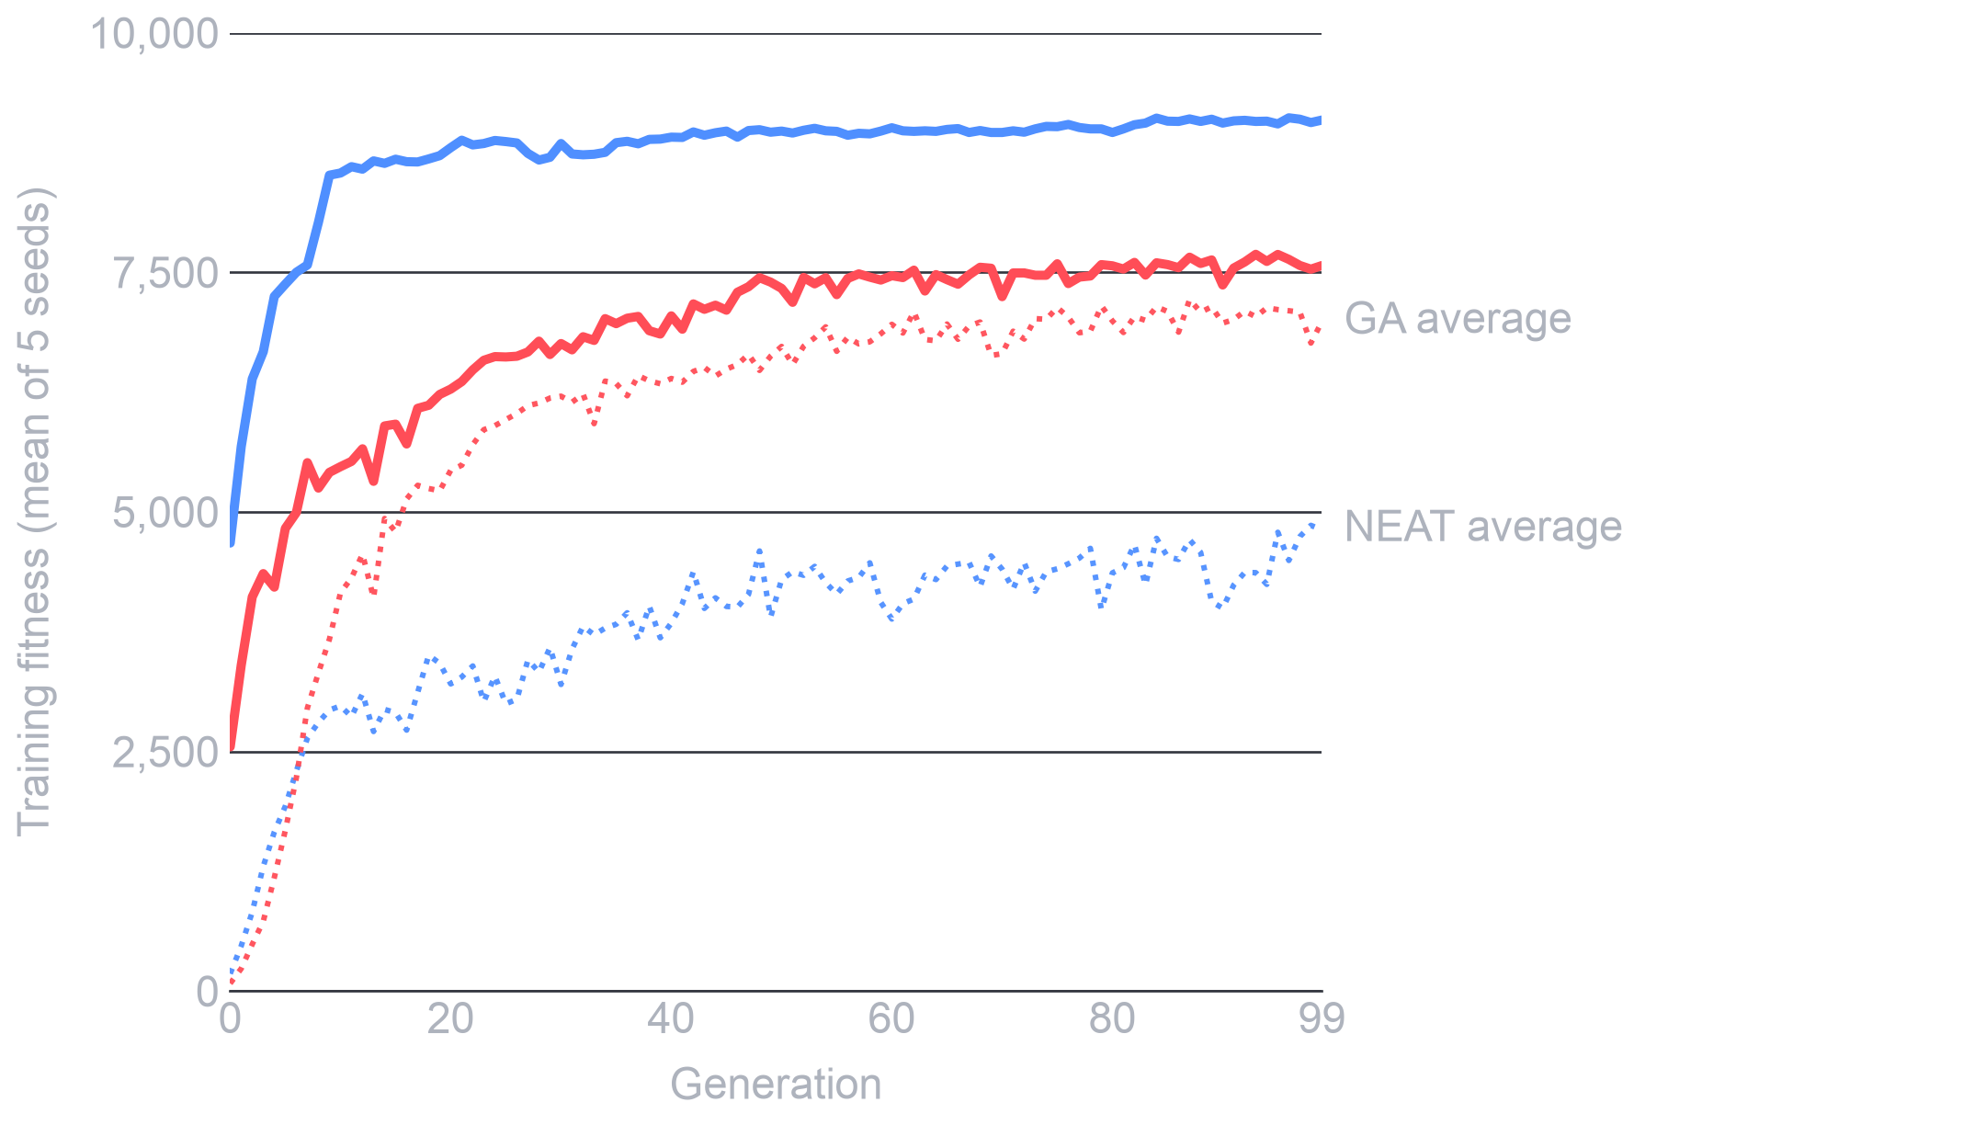
NEAT's best is higher, its average lower
LEARNING
8,537
NEAT best at generation 10 (GA: 5,473)
6,987
GA final average (NEAT: 4,812)
NEAT's population stays more mixed.
Notes:
Solid lines are the best driver in each generation, dotted lines are the population average. By generation 10, NEAT's best is already about 8,500 vs about 5,500 for the GA. The GA population converges and its average gets close to its best. NEAT's average stays much lower. Speciation may be why, since it protects weaker but different networks, but we have not tested that. Each generation uses a new episode seed, so best-of-generation values are noisy and a bit optimistic. That's why champions are picked on fixed validation seeds.

Slide 10
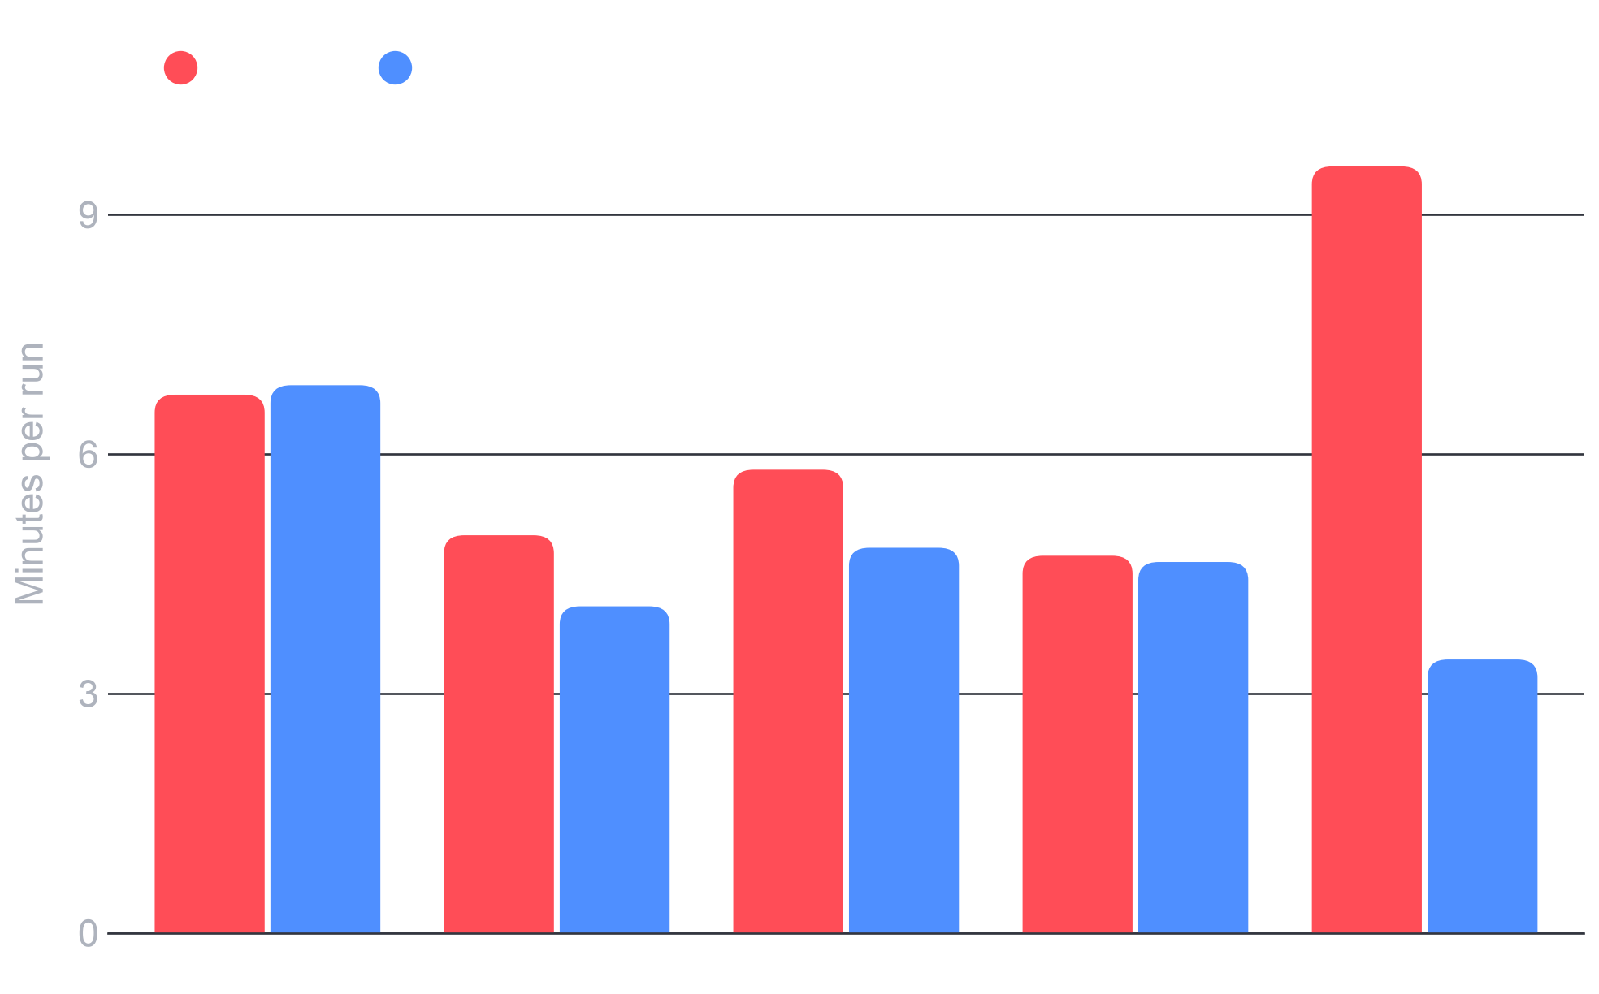
A run takes about 5 to 6 minutes
COST
6.4 min
GA average per run
4.8 min
NEAT average per run
≈ 5.6 hours
30 seeds each, on one laptop
Notes:
Every run: 10,000 evaluations on 7 tracks with 4 workers on one laptop. GA runs took 4.7 to 9.6 minutes and NEAT took 3.4 to 6.9. This wasn't a controlled benchmark, since we didn't control what else the laptop was doing, so don't over-read the GA vs NEAT time difference. All runs meet our target of 100 generations in under 10 minutes. 30 seeds each comes to about 5.6 hours, about 4.6 of which are still to run.

Slide 11
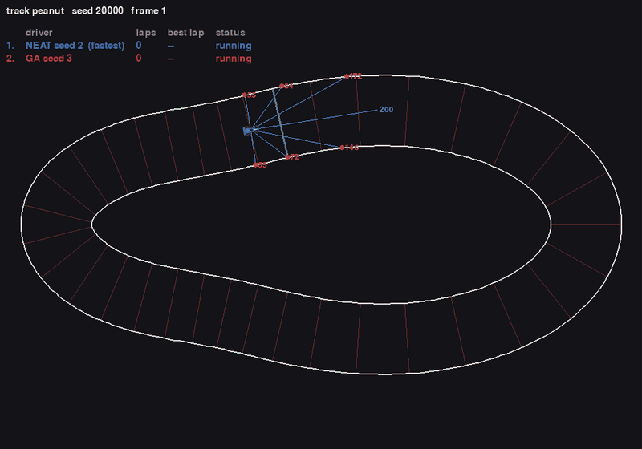
GA vs NEAT on peanut
DEMO
GA seed 3
0.86
laps, then crashes
NEAT seed 2
3.03
laps, no crash
GA failure: leaving the tight end at full speed.
Notes:
This clip plays during the slideshow. It's test seed 20000, with both cars starting together. We picked this pair to show the failure, so it isn't a fair sample of each method: each has seeds that crash and seeds that lap.
For a live version, on main:
python3 -m evo.replay results/ga/default/seed3/champion.json results/neat/default/seed2/champion.json --track peanut --seed 20000

Slide 12
Next steps
WHAT'S NEXT
1
Add a random baseline
Limits today
Same budget, on the 7-track split
Run 30 seeds per method
5 seeds
2
With statistical tests, about 4.6 more hours
per method is too few to call a winner
3
Add a new test track
Peanut
One we never tune on
shaped our design choices, so it isn't fully unseen
4
Add more methods
CMA-ES, then DE and MAP-Elites
No random baseline
Run ablations
yet on the 7-track split
5
Population, mutation, selection, elitism
Notes:
The first three steps make the main result trustworthy. Peanut influenced our design, since we saw the crashes and then changed the training set, so a new track we never tune on gives a cleaner test. CMA-ES, DE and MAP-Elites come from the extended proposal. We also still need to report mean lap time, which the proposal promised.

